Slide 1
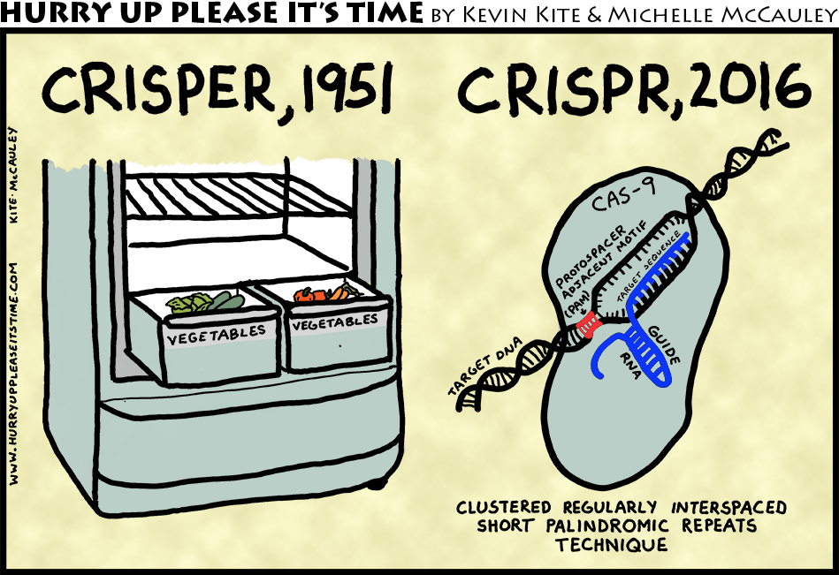
Project 2.1: Identifying Off-Target CRISPR Sites

Slide 2
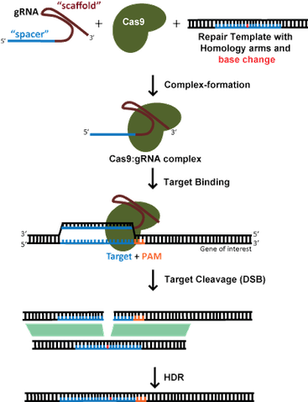
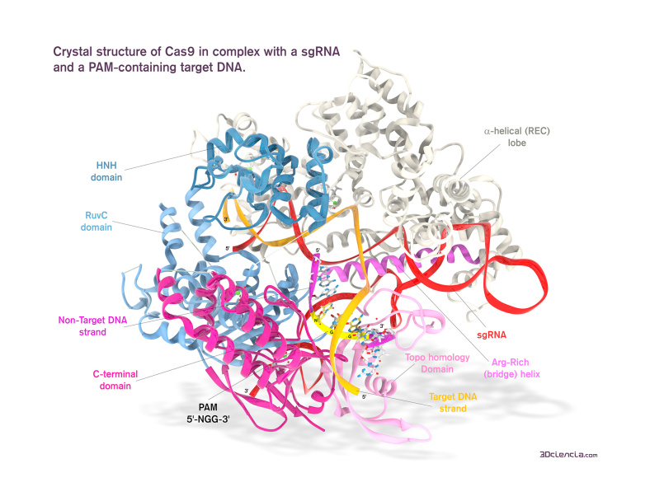
What is CRISPR?
A new tool to allow precise genome editing
Notes:
https://www.addgene.org/crispr/guide/
https://3dciencia.wordpress.com/2015/06/11/the-cas9-sgrna-dna-complex/

Slide 3
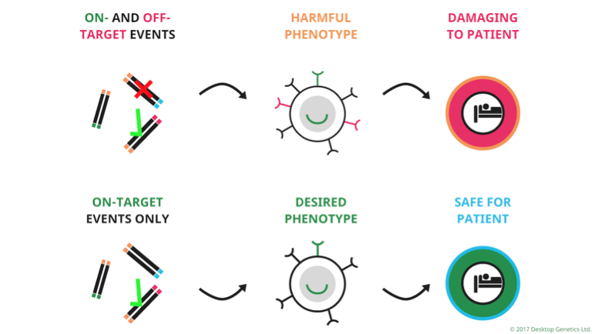
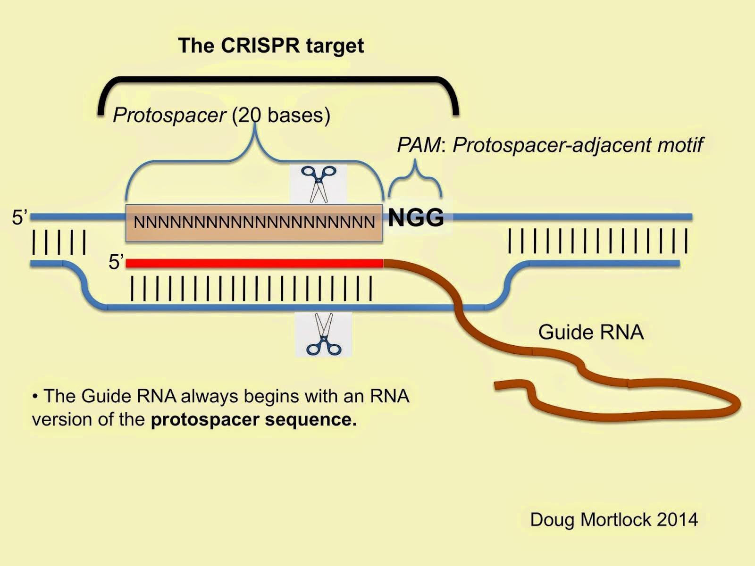
Off-Target Effects
The major setback for clinical CRISPR/Cas9 use
human genome
3,000,000,000 base pairs
“NGG” occurs ~ 160,000,000 times
gRNA
20 bases (12 absolute)
… A LOT of potential binding sites!
Notes:
https://www.addgene.org/crispr/guide/
https://3dciencia.wordpress.com/2015/06/11/the-cas9-sgrna-dna-complex/
https://www.idtdna.com/pages/docs/default-source/synthetic-biology/crispr_faq_043015.pdf?sfvrsn=2

Slide 4
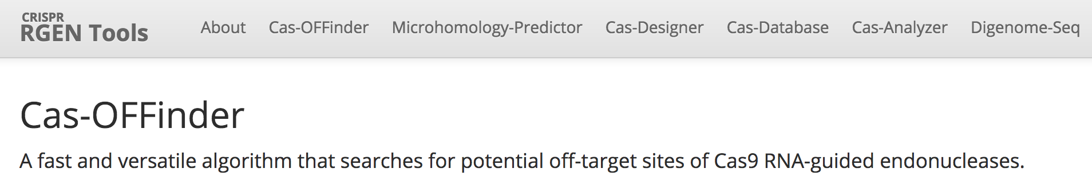
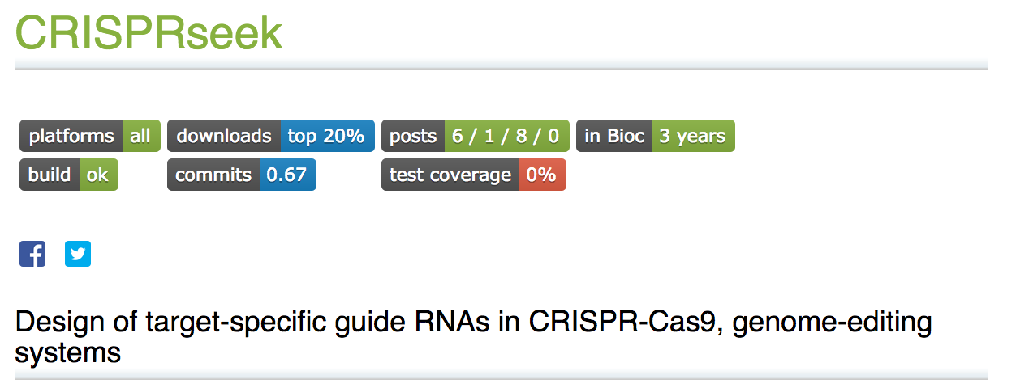

Goal: How to predict off-target sites?
Computational methods to assess gRNAs

Slide 5
Principles of CRISPR/Cas9 Specificity
PAM site
gRNA: PAM Proximal vs PAM Distal
Chromatin Structure
Methylation
Cas9 Related Factors
PAM site
gRNA: PAM Proximal vs PAM Distal
Chromatin Structure
Methylation
Cas9 Related Factors

Slide 6
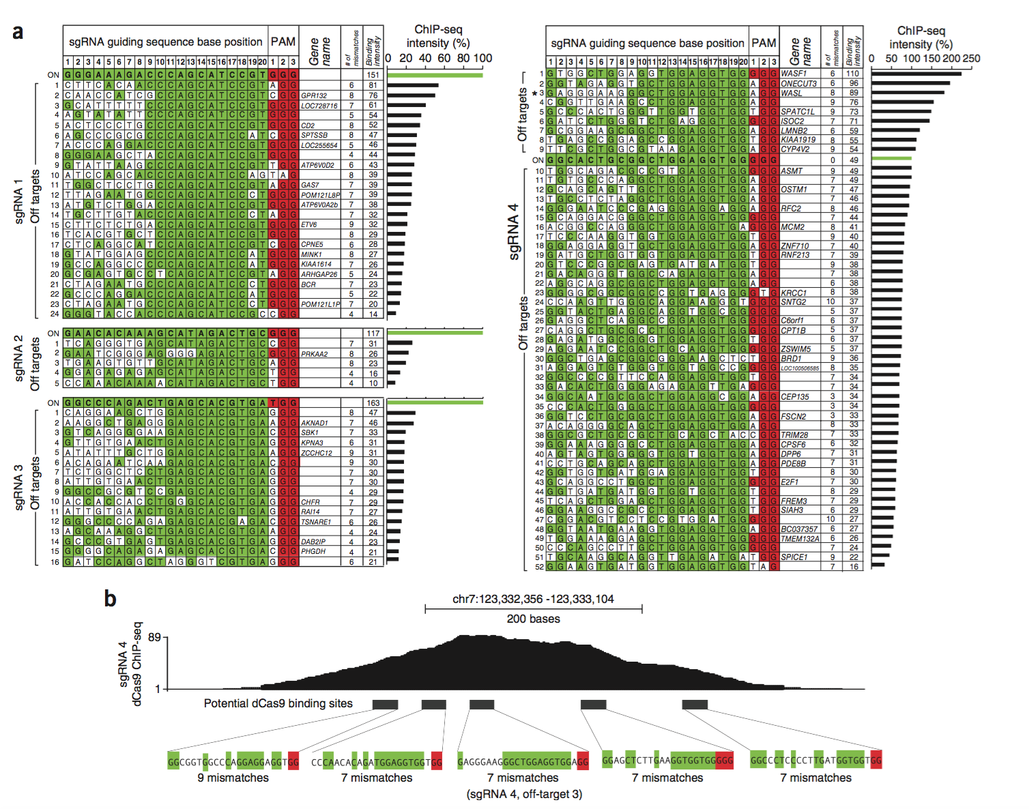
Proximal >> Distal
gRNA tolerates ~7-10 mismatches in Distal
gRNA must be 20 bases
Kuscu, Cem, Sevki Arslan, Ritambhara Singh, Jeremy Thorpe, and Mazhar Adli. "Genome-wide analysis reveals characteristics of off-target sites bound by the Cas9 endonuclease." Nature Biotechnology32.7 (2014): 677-83. Web.

Slide 7
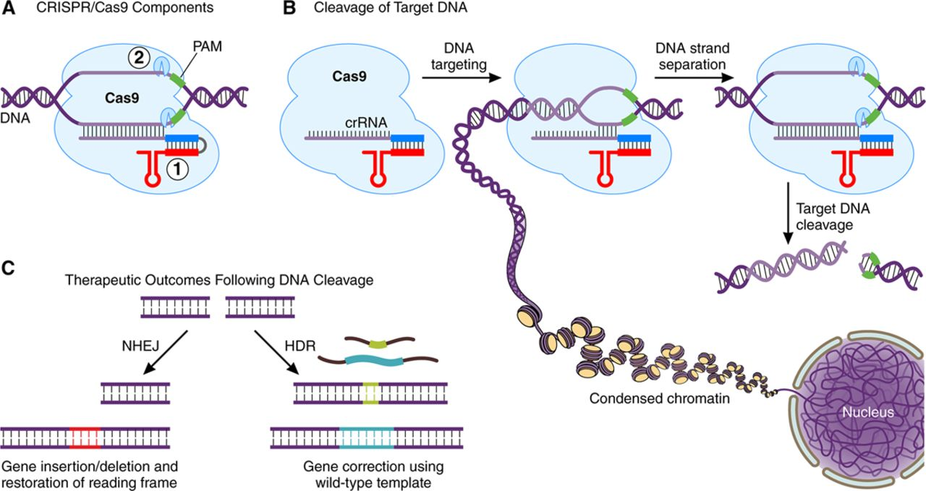
Chromatin Structure
Cas9 preferentially accesses open chromatin
ENCODE contains ChIP-seq data detailing chromatin structures in cells
Notes:
http://circ.ahajournals.org/content/circulationaha/134/11/777/F1.large.jpg

Slide 8
Sequence information is multidimensional
Seq1 | Seq2 | Seq3 | Seq4
A | T | A | A
G | T | T | T
A | A | A | A
C | C | T | T
C | C | G | C
C | T | T | C
A | A | A | A
x_{1,}x_{2,}x₃..x₈

Slide 9
Multidimensional spaces feature alternative geometries
Oversimplified example: flight from NYC to Moscow
Euclidean Distance: traditional geometric distance
- Simple: Pythagorean theorem, Norms
Straight line
Through the mantle of the earth
Manifold Distance: distance along the curve or surface
Found via “walking” over the surface
Curved line
Over the surface of the earth

Slide 10
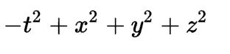
There are many multidimensional geometries
Eg. Minkowski geometries
Simply a weighted distance metric on each dimension
Classical example: 4d Euclidean spacetime:

Slide 11
Minkowski weighting of sequence information defines relative importance of each sample
Seq1 | Seq2 | Seq3 | Seq4
A | T | A | A
G | T | T | T
A | A | A | A
C | C | T | T
C | C | G | C
C | T | T | C
A | A | A | A
d(Seq1, Seq2) = √ ∑a_{i}(x_{2i}-x_{1i})²
We set a_{i} to weigh the ”seed” region of the guide RNA more
x_{1,}x_{2,}x₃..x₈

Slide 12
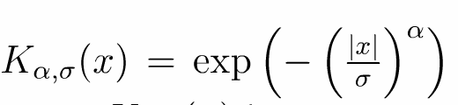
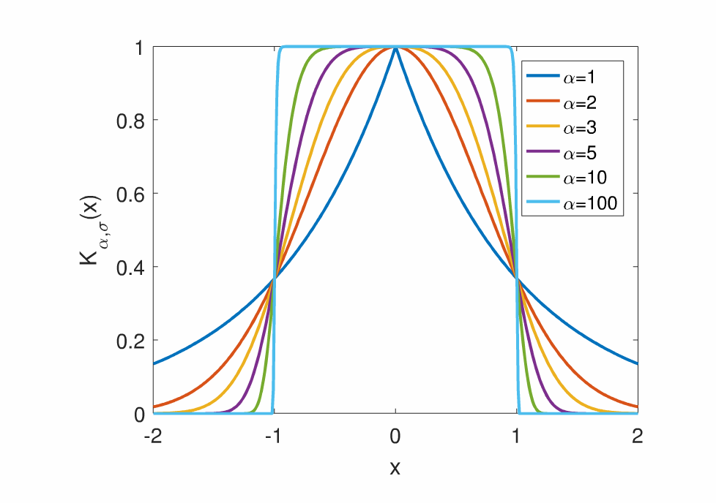
Defining a kernel over seq space yields connected sequences

Slide 13
Defining a kernel over seq space yields connected sequences

Slide 14
How to walk?
Just power the sequence transition matrix (defined by the kernel) t times, where t is identified using a measure of information in the sequence relationships
If you powered it infinite times, you would have the steady-state probabilities of the matrix. You could find this with the first eigenvector

Slide 15
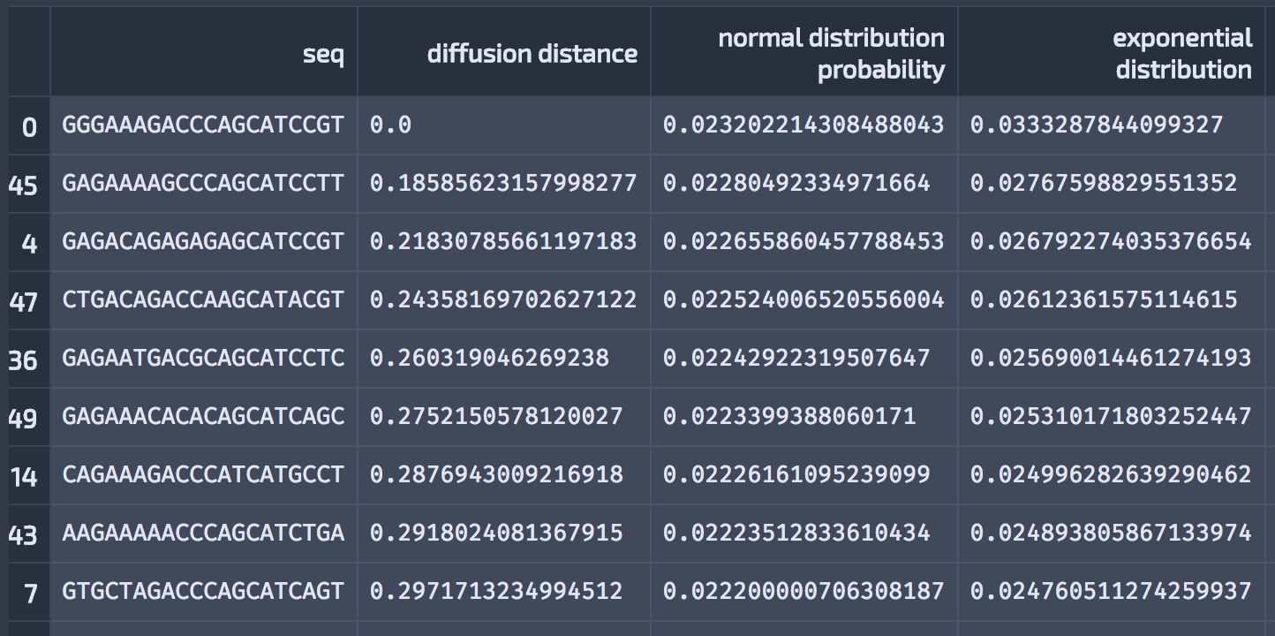
Okay, we’ve walked, what does that mean?
We’ve now walked onto a manifold and the corresponding probabilities can be viewed as potential distances using a -log transform.
These manifold distances are then mapped into probability distributions.

Slide 16
Pipelining to Identify Off-Target Effects
Many published tools, limited experimental data
Haeussler et al. 2016 published a compilation of 31 guides and 650 experimentally validated off target sites

Slide 17
Pipelining to Identify Off-Target Effects
Many published tools, limited experimental data
Haeussler et al. 2016 published a compilation of 31 guides and 650 experimentally validated off target sites
Pipeline goal: compare the performance of two pipeline tools on this dataset

Slide 18
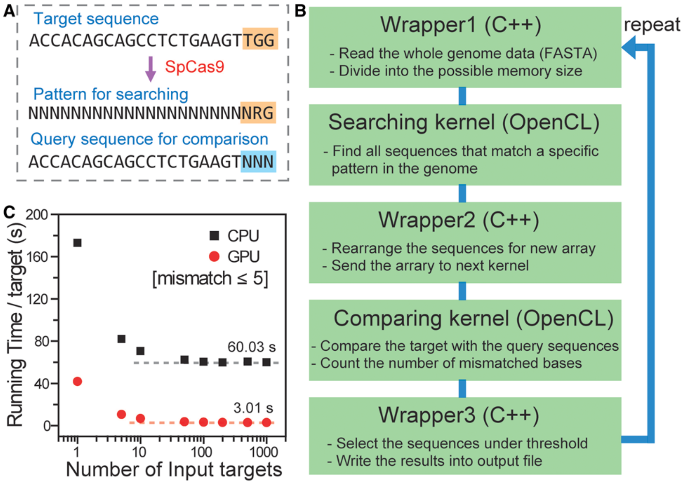
Pipeline: Algorithm 1 - Cas-OFFinder

Slide 19
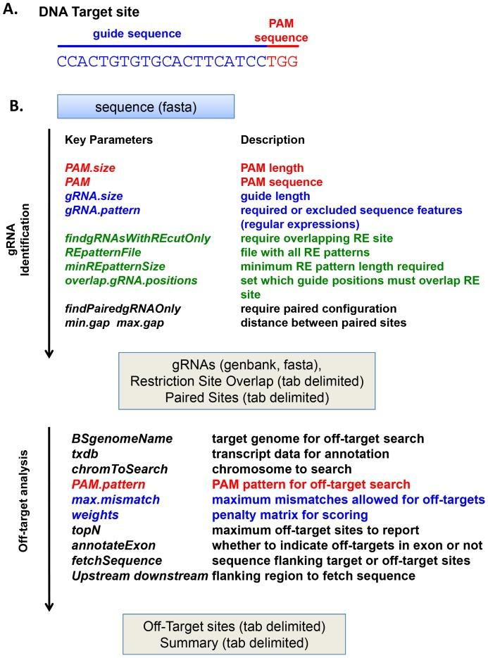
Pipeline: Algorithm 2 - CRISPR-SEEK

Slide 20
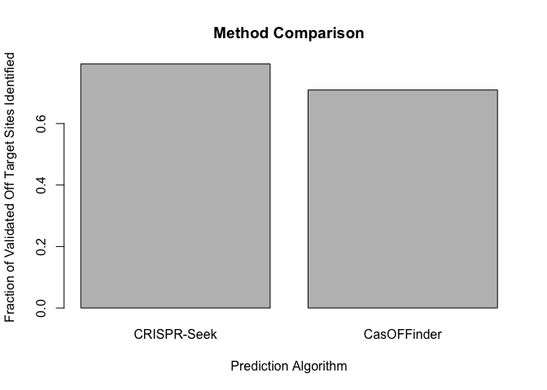
Pipelining Results on hg38
CRISPR-Seek: 516/650
CasOFFinder: 461/650

